Slide 1



PIN Diamond Diodes for Alpha Particle Detection
Holly Johnson, Anna Zaniewski, Jason Holmes, Ricardo Alarcon, Manpuneet Benipal, Franz Koeck, Jesse Brown, Harshad Surdi, Robert Nemanich
Arizona NASA Space Grant Symposium
Arizona State University - Tempe

Slide 2

Two important questions:
1) Why PIN diamond?
2) Why alpha particles?

Slide 3
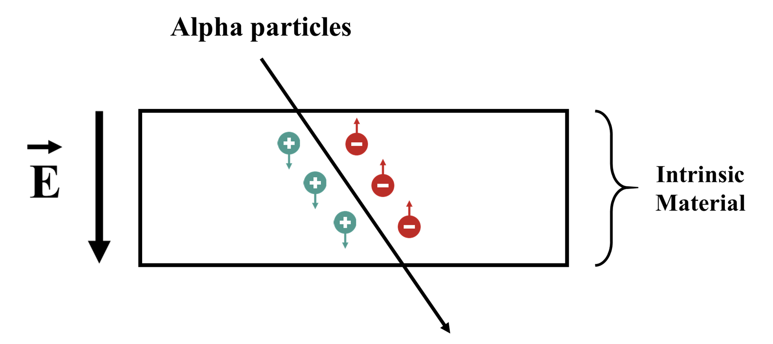
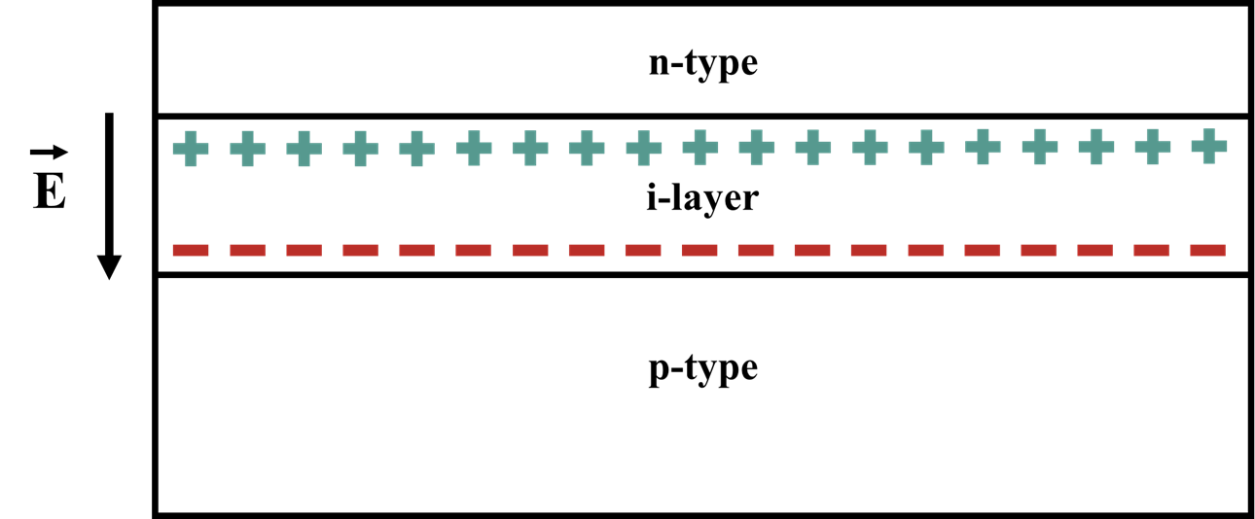
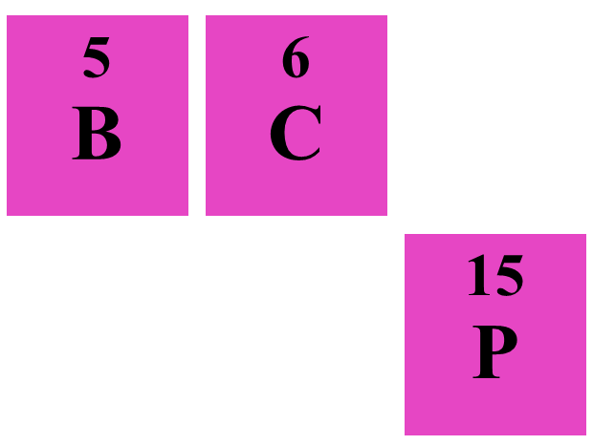
The Physics of Diamond Detectors
Intrinsic material
  Semiconductor
Connected to a circuit
  Apply an external bias
  IV-response

Slide 4
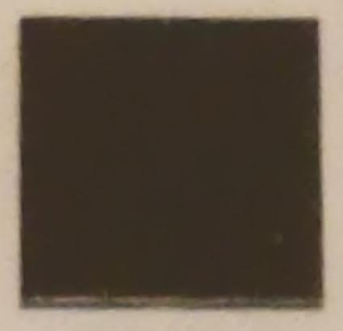
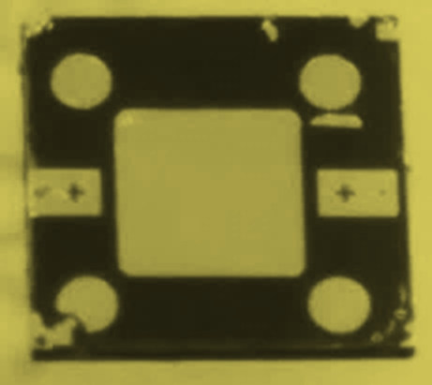
Process?

Slide 5
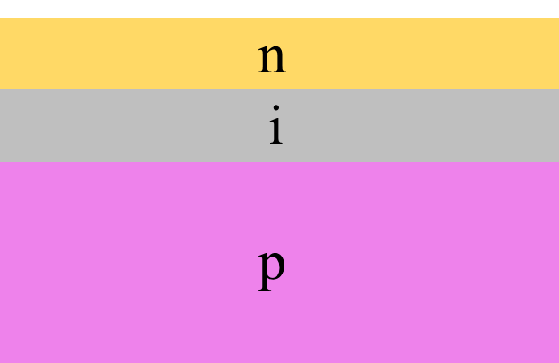
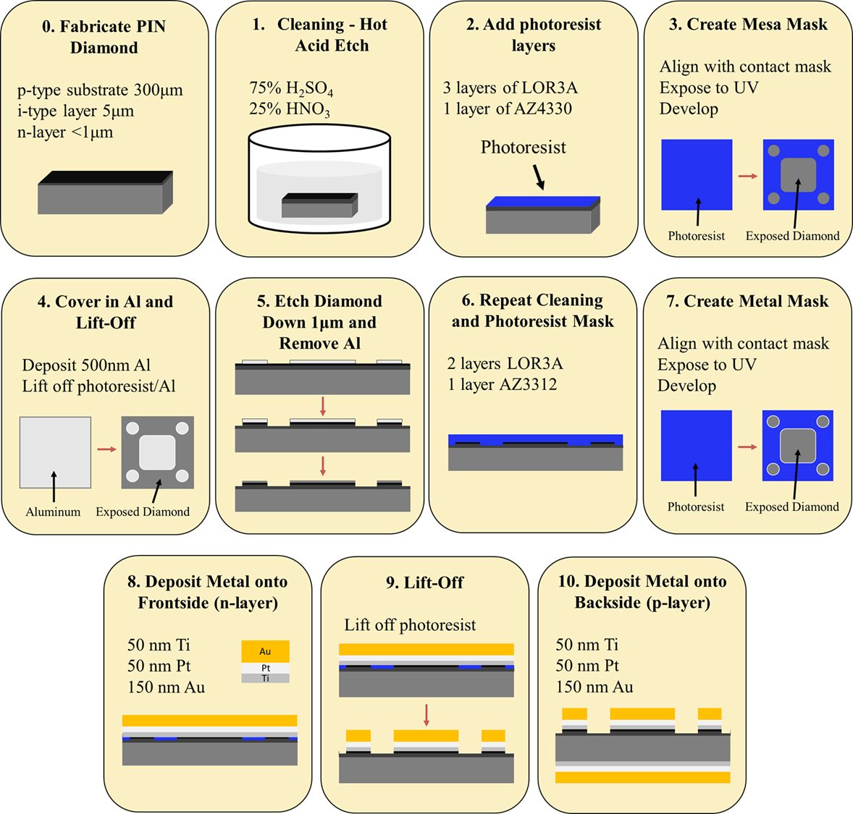
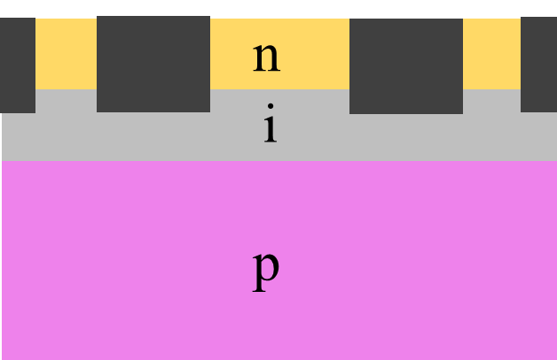
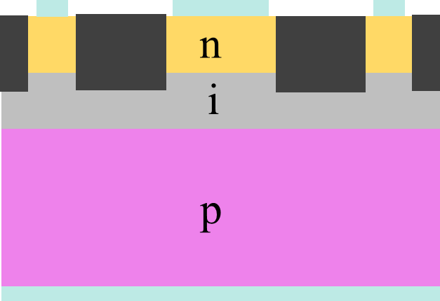
Mesa Etch and Metal Deposition

Slide 6
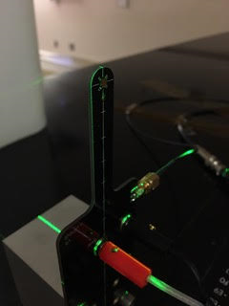
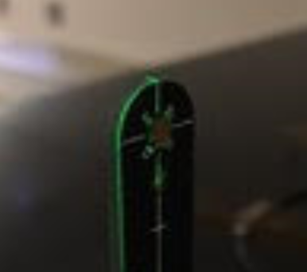

Slide 7
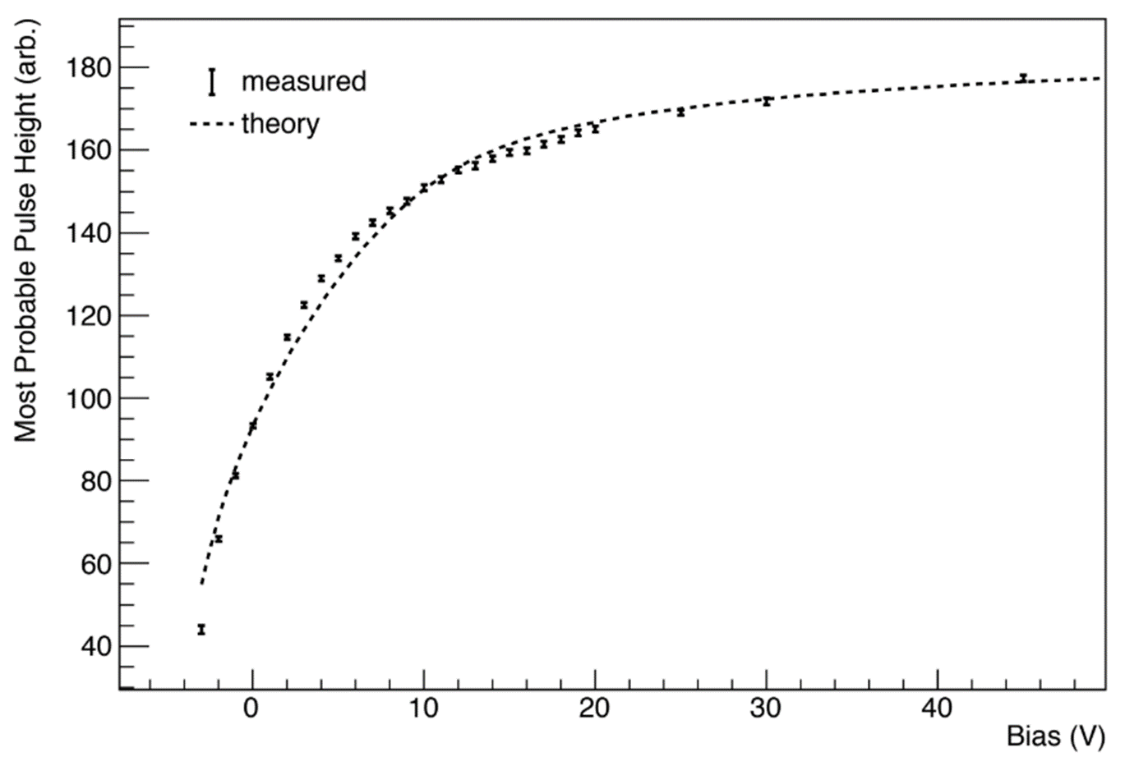
Testing with Polonium-210
Current (Arb.)

Slide 8
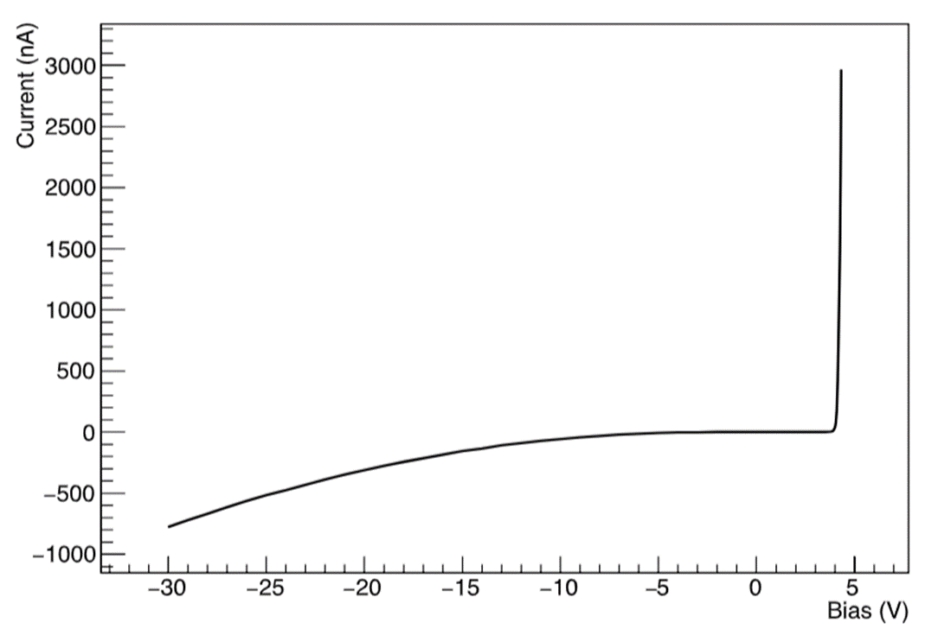
Testing for Diode-like Behavior

Slide 9
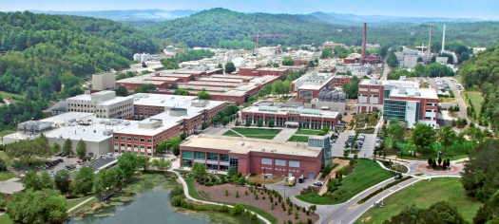
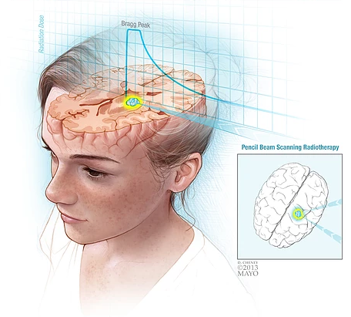
Applications and Next Steps
Nuclear energy
Nuclear waste
Extreme environments
  Venus
Medical physics
Testing at Oakridge National Lab
Diodes
Particle Therapy Cancer Research Institute: Introduction, Oxford Martin School, https://www.ptcri.ox.ac.uk/research/introduction.shtml. Accessed 28 Mar. 2018.
https://www.energy.gov/orem/cleanup-sites/oak-ridge-national-laboratory

Slide 10
Acknowledgements
I would like to acknowledge my mentor Anna Zaniewski for guiding and supporting me in my endeavors. I also want to recognize Manpuneet Benipal and Jason Holmes for invaluable contributions to this project. I would also like to acknowledge Robert Nemanich, Ricardo Alarcon, Franz Koeck, Jesse Brown, Harshad Surdi, Yichen Yao, Raghuraj Hathwar, and Stephen Goodnick for helpful discussion.

